Slide 1
DEVELOP AN OUTCOME L2
Evidence of Learning Template
Maze Game:
Marick Malamala
YOUR NSN NUMBER HERE

Slide 2
https://drive.google.com/file/d/1u_nbmIQ93P6Ag3fww932ZuOueN_z8WV7/view?usp=sharing
Trello board or PM link
You MUST provide evidence showing how the problem has been decomposed, how the components have been developed and trialled, and of how they have been assembled and tested to create a final, working outcome.

Slide 3
Project management: Setup
Record evidence that you have setup project management tools to manage the development of your outcome.
Record evidence that you have chosen project management techniques to manage the development of your outcome.
Record evidence that you have setup/ chosen version control tools/techniques to manage the development of your outcome.
Explain why you believe that these tools and techniques are appropriate for the development of your outcome.

Slide 4
Setup
I did not use a project management tool, however I did follow the course calendar and used week term planning. For the first few weeks I was just learning the basics and researching stuff such as what library to use and how to make the character move by pressing the arrow keys on the keyboard. I started coding at week 4 as there was a checkpoint in week 6 and I had to have complete at least 40%.

Slide 5
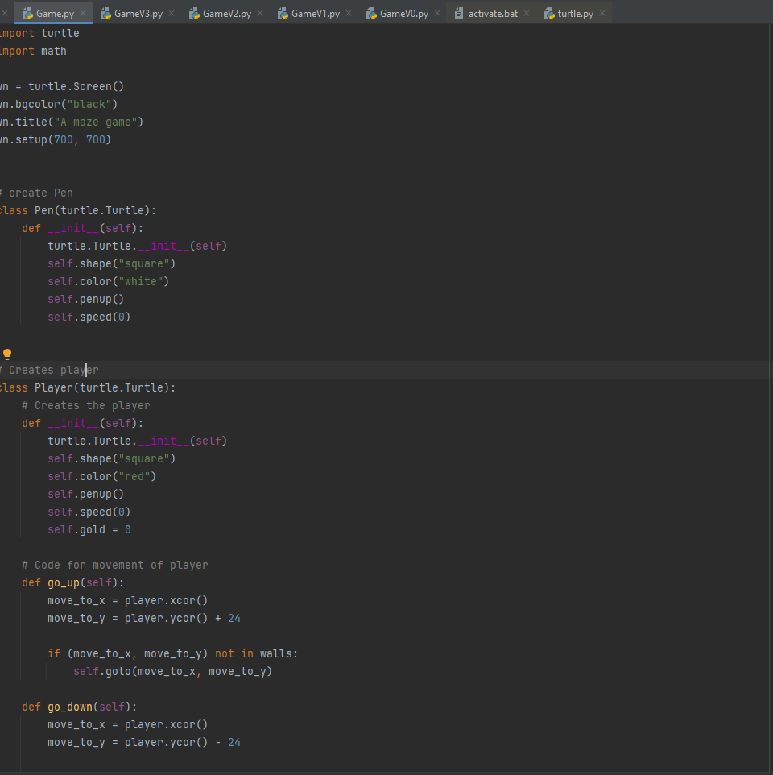
Setup
While coding I made different versions of the code. This helped kept track of how much work I was doing and if the file ever got corrupted I could always go back to the earlier versions.

Slide 6
Setup
These tools and techniques were appropriate for the development of my outcome as it made time management more easier and knowing what needed to be done and when it needed to be done was crucial. It was crucial as it was my first time coding a game and I needed to learn stuff like how to make the character move and how to create the walls.

Slide 7
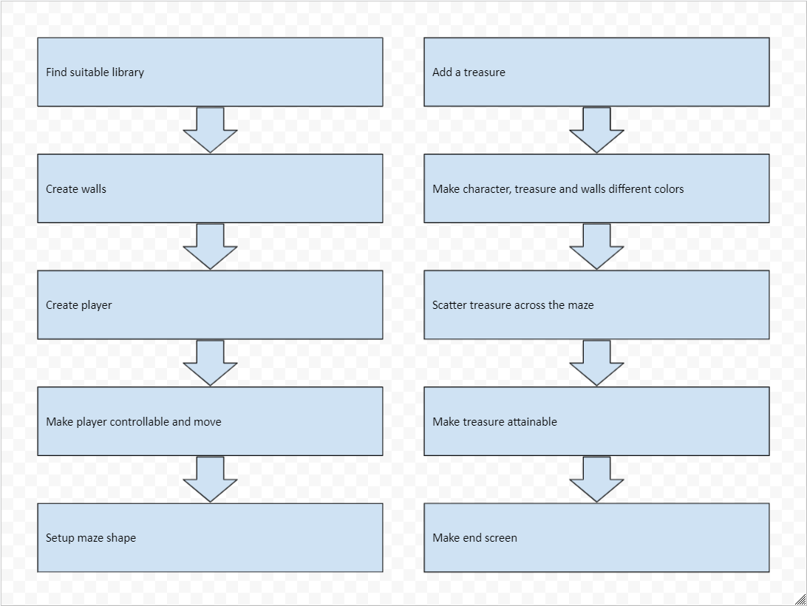
Decomposing outcome
Record evidence that you have broken the outcome into smaller components.

Slide 8
Trialling components
Record evidence that you have trialled components. Show that you gathered information to inform your decision making.
Record evidence that you have trialled multiple components and have selected those most suitable.
Record evidence that you have used information from trialling appropriately to improve the functionality of the outcome.

Slide 9
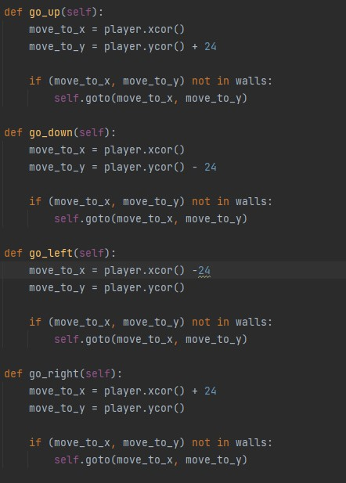
When testing the game for the first time I noticed that the player would just go straight through the wall so I had to make a code so that the wall acts as a wall and stops the character from moving through them.

Slide 10
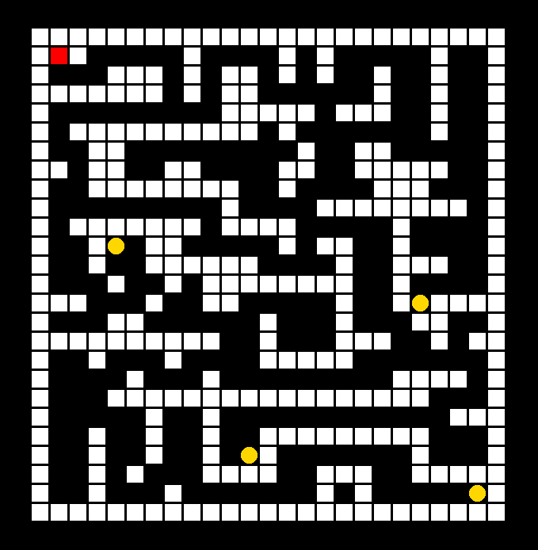
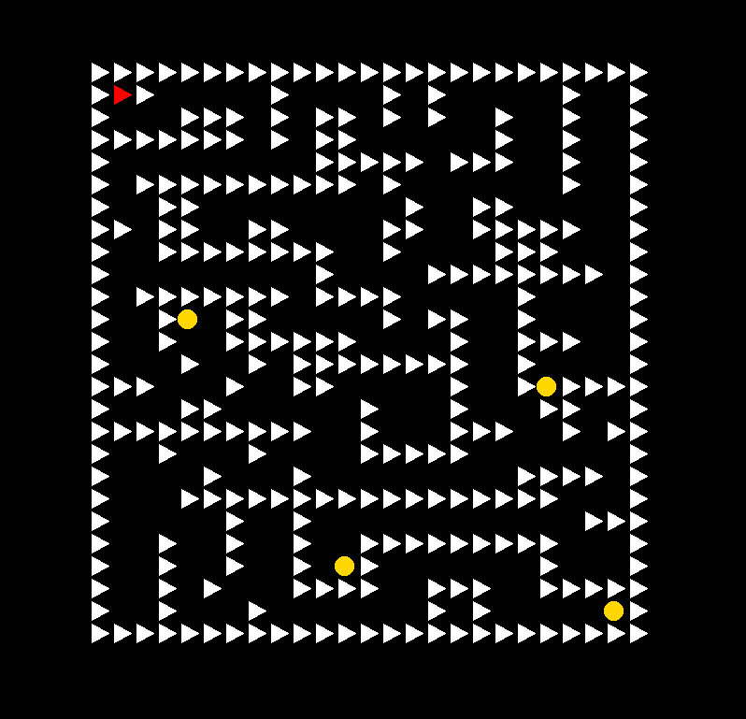
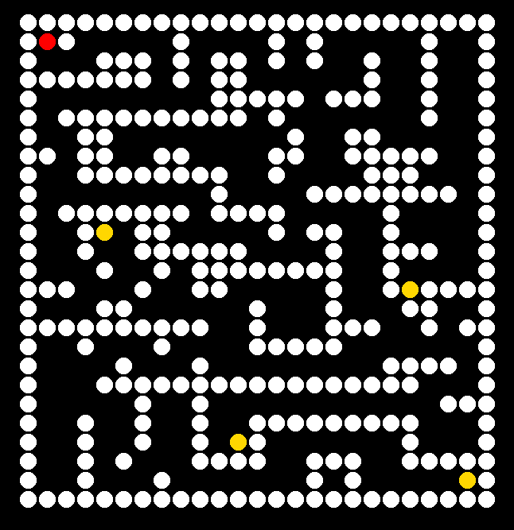
I tried out different shapes for the wall and player class and ultimately I went with the circle one as it didn’t look as chunky as the squares and not as out of place as the triangles. In my opinion, it is the most appealing one out of the three.

Slide 11
Trialling components
Testing the game informed me that the player was going through the wall therefore I needed to make the walls solid, making the walls work as intended and improving the functionality of the outcome. Testing the different shapes gave me a range of options to choose from and choosing the circles just made the game look cleaner.

Slide 12
Testing outcome
Record evidence that you have tested your outcome.
Explain how the testing made sure your outcome functions as intended to meet its purpose and requirements.
Record evidence that you have used information from testing appropriately to improve the functionality of the outcome.

Slide 13
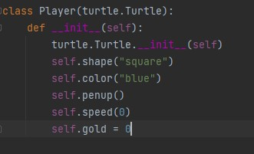
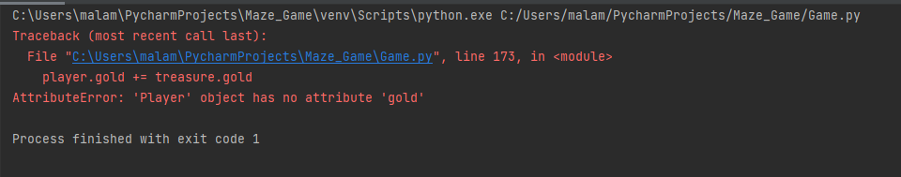
Testing
After adding the treasure class I tested my program and every time the player came in contact with the treasure, it would crash the game and an error would pop up saying “‘Player’ has no attribute ‘gold’” so I went back into my code and added “self.gold = 0” to my Player class.

Slide 14
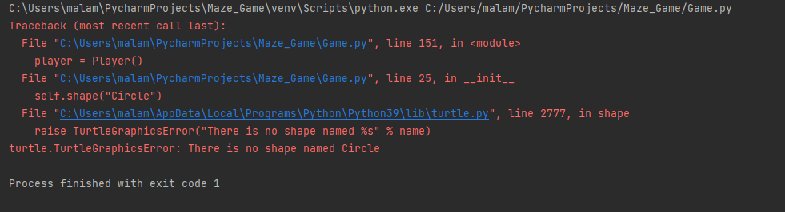
Testing
There was also a problem when I added the shape of the player which would cause the game to crash on launch and I needed to change the self.shape(“Circle”) so that the c in Circle was lower cased for the game to launch properly and function as intended.

Slide 15
Testing
The testing of my programme made sure that my maze game was working as intended as it pointed out mistakes such as the game crashing after colliding with the treasure and the player going through the walls. This helped the outcome meet its purpose and requirements which was a properly functioning game.

Slide 16
Project management: Applied
Record evidence that you have used your project management tools to manage the development of your outcome.
Record evidence that you have used your project management techniques to manage the development of your outcome.
Record evidence that you have used version control tools to manage the development of your outcome.

Slide 17
Version Control

Slide 18
Relevant Implications
Explain the relevant implications here. Please watch this video to learn how to do this.
Explain the Implications that are relevant to your outcome.
Record evidence that you have addressed the Implications that are relevant to your outcome.

Slide 19
Implications
Legal: All and any code that I have taken from someone else will not be used for my own gains and will not be published as my own as this falls under copyright laws.
Social: My game does not contain anything offensive and it can be enjoyed by people of any age, color blindness or people with disabilities.
Usability: My game is very user friendly and straightforward which means it can be accessed and navigated by anyone.

Slide 20
Evaluate
Discuss how the information from planning, testing and trialling of components assisted in the development of a high-quality outcome.
I used the course calendar as a way to keep track of my time and how much of it I had left. This helped as it helped me keep track of how much work I needed to do each day to have a complete and functioning outcome.
I tried out different shapes and colours with my friends. This gave me an idea of how to improve and make my maze game better for everyone to enjoy. This allowed me to make a maze game which appealed to a lot of people.
I tested my game multiple times as I was adding more and more to it such as the time when I tested the treasure. These tests helped me develop a high quality game as with every test, there were improvements to be made and mistakes to be fixed.

